Slide 1

DELTA DENTAL OF CALIFORNIA
FORM A HEARING
Michael J. Castro, Acting Chief Executive Officer
Michael G. Hankinson, Esq., EVP and Chief Legal Officer
OCTOBER 29, 2018

Slide 2

OUR PURPOSE
WHO WE ARE
OUR MISSION
  To advance dental health and access through exceptional dental benefits service, technology and professional support
  Creating smiles. Improving health. Enhancing lives.
OUR VALUES
  Trust. Service. Innovation. Excellence.

Slide 3
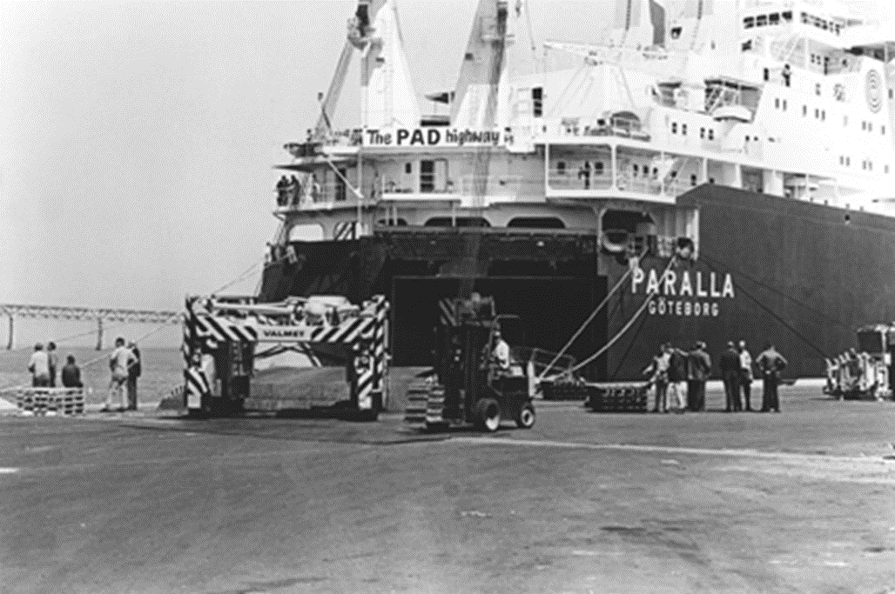

WHERE IT ALL BEGAN
Delta Dental, and dental insurance itself, was founded in California in 1955 by dentists (CDA) to increase access to oral healthcare.
The International Longshoremen’s Union sought a partner to provide insured dental care for their members’ children. Delta Dental was born. This 60-year partnership continues today.

Slide 4
OUR ENTERPRISE
Largest dental carrier in country
KEY FINANCIAL METRICS
  $9.2 billion in revenue
  $225 million in 2018 net gain
  $1.5 billion in general reserves
  37 million total enrollees
KEY OPERATIONAL METRICS
  3,715 employees
  44.7 million claims processed (Avg claims turnaround 3.9 days)
  21.5 million calls answered (98.6% resolved on first call)

Slide 5
ENTERPRISE TIMELINE
Mexico
Puerto Rico and US Virgin Islands
DDC
DDIC
DDP
DSD
DDPR
1955
1980
2000
2007
2014
CONFIDENTIAL : NOT FOR FURTHER DISTRIBUTION

Slide 6
ENTERPRISE STRUCTURE
DDC
Delta Dental of California
ALABAMA
FLORIDA
DDP
Delta Dental of PA Delta Dental of NY
DELAWARE
DISTRICT OF COLUMBIA
GEORGIA
LOUISIANA
MISSISSIPPI
MONTANA
NEVADA
TEXAS
UTAH
MARYLAND
NEW YORK
PENNSYLVANIA
WEST VIRGINIA
DSD
Dentegra Seguros Dentales
MEXICO
DDPR
Delta Dental of Puerto Rico
PUERTO RICO 63.9% OWNERSHIP
DDIC
Delta Dental Insurance Company
CALIFORNIA
Not-for-Profit
For Profit
Not-for-Profit
For Profit
For Profit
CONFIDENTIAL : NOT FOR FURTHER DISTRIBUTION

Slide 7

“A” RATING : AM BEST
“…improved capitalization, an economic shift to a higher level of earnings and the execution of business expansion strategies….”
“…streamlining operations and making investments to modernize (its) information and technology infrastructure, which has improved efficiency, generated cost savings and raised market penetration in both insured and uninsured businesses.”
CONFIDENTIAL : NOT FOR FURTHER DISTRIBUTION
Notes:
A.M. Best, the leading independent health care rating agency, awarded our enterprise companies an “A” (Excellent) rating with a stable outlook. This upgraded rating reflects our marketplace gains, the success of our new technology and other initiatives that are helping to reduce administrative expenses. According to AM Best, we are well positioned for future growth and stability.

Slide 8
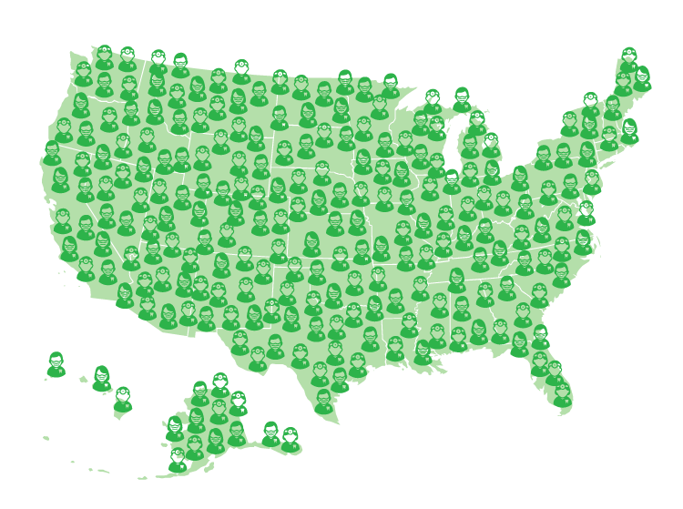
NETWORK ADVANTAGE
The Delta Dental Difference®
NATIONAL NETWORK
152,000 network dentists
Delta Dental PPO
269,841 access points
Delta Dental Premier
340,535 access points
DeltaCare USA
61,833 locations
CONFIDENTIAL : NOT FOR FURTHER DISTRIBUTION
Notes:
Total National Network based on latest NPF and unique and access points reports from My DPPA:
Over 152,000 network dentists
Over 351,000 locations
79% of all U.S. dentists are Delta Dental dentists
The MyDDPA stats by network as of April 5, 2017 reports:
PPO Access Points = 269,841
Premier Access Points = 340,535
DeltaCare Access Points = 61,833

Slide 9
CUSTOMER SEGMENTS
Employer Groups
Medicaid
97.9%
ENROLLEE
RETENTION RATE
Federal
Medicare Alliances
Direct to Consumer
Public Exchanges, AARP, Costco, other
Private Exchanges
CONFIDENTIAL : NOT FOR FURTHER DISTRIBUTION

Slide 10


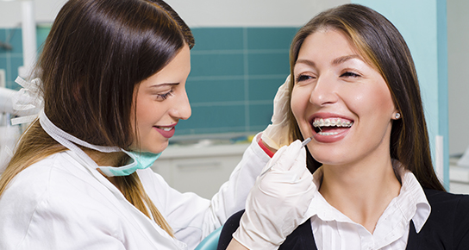
DELTA DENTAL CHARITABLE GIVING
Foundation Grants Paid to Exceed $14.5M in 2018
  Collectively contribute over 10% of net income annually to support community groups and oral health
  Monetary Grants to 325 clinics in rural and underserved areas
  Funding also supports health, education and research projects in dentistry, health and human services and civic and community affairs
  2018 GRANT FUNDING INCLUDES
  Access to Care : $11.2M
  Oral Health Education : $1.9M
  Scholarships : $430k
  Corporate Giving : $299k
  Disaster Relief Funds : $270k
  Community Giving : $261k
  Scientific Research : $100k
10
CONFIDENTIAL : NOT FOR FURTHER DISTRIBUTION
Notes:
Our success as an organization depends on how each of us contributes.
As you’re going about your workday and supporting each other in terms of meeting our corporate goals, focusing on our customers and committing to our cultural transformation, you are making a difference. Your dedication to doing your very best as an integral part of our team enables us to do some truly amazing things in our communities. You are part of something bigger here at Delta Dental.
As an organization, we’ve always given back to our communities; however, we’ve traditionally kept a low profile when it comes to our philanthropy. Many of you may not even know we have an established charitable Foundation.
Our Foundation, the Delta Dental Community Care Foundation annually awards grants to nearly 400 clinics that provide desperately-needed dental care to children and adults who cannot afford it. Eliminating suffering due to dental disease and improving quality of life is our Foundation’s vision.
The Foundation is able to do this and more because of you.
As an organization, we also set aside funds each year to make direct corporate donations from each of our various companies. These monies are used to fund dentally-focused health, education and research initiatives, as well as grants supporting other community initiatives that provide services to those who are less fortunate. We give back.
When you work hard to meet your goals and model our success attributes of accountability, collaboration, communication and discipline around fundamentals, you’re contributing to us remaining financially healthy. You’re helping to ensure we’re following all applicable laws and regulations and being legally responsible. You’re promoting an organization that treats its employees and community in an ethically responsible manner, and you’re part of the reason why we can go above and beyond in terms of benefitting society through our philanthropy.
These concepts of economic, legal, ethical and philanthropic responsibility are part of the larger concept of corporate social responsibility – our impact on environmental and social wellbeing.
I look forward to sharing more about what we’re doing in terms of philanthropy in the weeks ahead. There’s a much bigger story to tell and a larger role you can play in it.
It begins with you.
Karen L. Robinson| VP, Corporate Affairs/Office of Corporate Secretary| krobinson@delta.org
office 415-974-8660 | cell 717-215-2192
Delta Dental of California| 100 First Street | San Francisco, CA 94105
We keep you smiling® | deltadentalins.com

Slide 11
WHAT’S THE DEAL?
STRATEGIC INVESTMENT
Deal documents signed and filed with Oregon regulators
Possible technical amendments to address tax planning, no substantive changes
Does not include the dental business (Oregon Dental Service)
Acquisition of slightly less than 50% of the common stock of Moda, Inc.
Acquisition price of $153M +/-
Payment through:
  debt conversion of $88M in principal + accrued interest
  ~$65M in cash at closing
Governance controlled by 5 person Moda board
  2 directors from Delta Dental
  2 directors from Moda
  Moda CEO is 5th seat
5th seat shifts to Delta Dental no earlier than 3 nor later than 5 years
CONFIDENTIAL : NOT FOR FURTHER DISTRIBUTION

Slide 12
WHO DOES THE DEAL BENEFIT?
BENEFITS TO MODA HEALTH PLAN
Strengthens balance sheet
Strengthens liquidity
Provides growth capital
Creates strategic relationship with strong financial partner
Enables Moda to partner to expand carefully, methodically
Enables Moda to further leverage its innovative knack and knowhow
Enables the Moda management and staff to “exhale”
CONFIDENTIAL : NOT FOR FURTHER DISTRIBUTION

Slide 13
WHO DOES THE DEAL BENEFIT?
BENEFITS TO MODA HEALTH PLAN POLICYHOLDERS
Further strengthens balance sheet, liquidity, claims paying ability
Ability of MHP to further invest in product enhancements and process improvements that can benefit policyholders
BENEFITS TO THE PUBLIC
Strengthens an Oregon Health Plan serving Oregonians
Strengthens and enables Moda to grow businesses that serve and
support both medical and dental Oregon providers
Solidifies the Moda workforce with its continuing contribution to
the Portland economy.
CONFIDENTIAL : NOT FOR FURTHER DISTRIBUTION

Slide 14
WHO DOES THE DEAL BENEFIT?
DELTA DENTAL OF CALIFORNIA ENTERPRISE
Enables DDC to begin realizing its goal of diversification from just stand alone dental benefit plans
Enables DDC and its affiliate plans to partner with Moda to offer bundled medical/dental offerings in DDC operating territories
Enables DDC to leverage Moda’s entrepreneurial knack and knowhow in starting and growing new businesses
Enables DDC to view business development opportunities through the new lens as a strategic investor and partner in a medical / dental / pharmacy benefits business
CONFIDENTIAL : NOT FOR FURTHER DISTRIBUTION

Slide 15
WHAT’S NEXT?
Regulatory Approvals from Oregon and the
Federal Trade Commission (Hart Scott Rodino filing)
Closing on 12/31/2018!
Conversion and cash provide debt relief and liquidity
DDC is not acquiring a controlling interest
DDC is not taking over the management
Moda is in control and managing their business
DDC is a strategic investor partner
Business as Usual
The future is bright!
CONFIDENTIAL : NOT FOR FURTHER DISTRIBUTION

