Slide 1


Homeowners Insurance
Home insurance covers your home, property, and those within the property.
Division of Financial Regulation

Slide 2
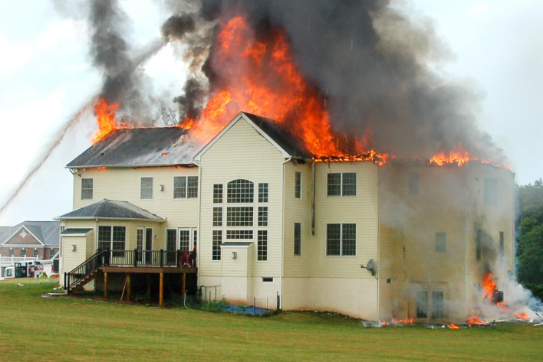

2
What is at risk?
What are you protecting?

Slide 3
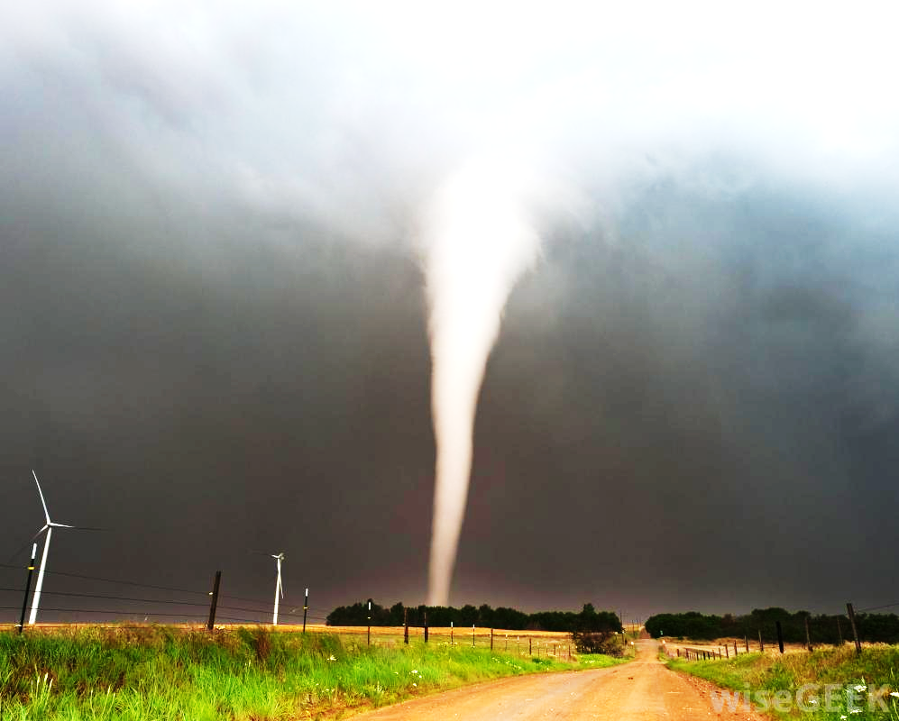
Covered
  Fire
  Theft
  Acts of nature (tree falling)
  Personal liability (“trampoline insurance”)
Not covered
  Earthquake damage
  Flood damage
  Neglect (leaking pipes, rotting tree)

Slide 4
Homeowners
Renters insurance
Covers
  Dwelling
  Out buildings
  Liability
  Personal property
  Additional living expenses
Required if you have a mortgage.
Covers
Personal property
Liability
Additional living expenses
May be required by landlord.

Slide 5
Insurance companies have:
  45 days to complete an investigation
  30 days to respond to an enquiry
  A legal right to inspect the damage before any repairs occur
Contact the Division of Financial
Regulation if you have a problem with your claim
888-877-4894 (toll-free)

Slide 6
ALE: Additional living expenses
  Your insurance company may pay for additional living expenses associated with your claim
  Hotel rooms, electric bills, meal costs, fuel costs, babysitter, etc.
** Keep track of ALL additional expenses **

Slide 7
Beware of restoration company “smoke chasers”
Work with your insurance company to find contractors
Do reference checks on contractors
Don’t pay till you are satisfied
Your mortgage lender may want to inspect repairs before payment is made

Slide 8
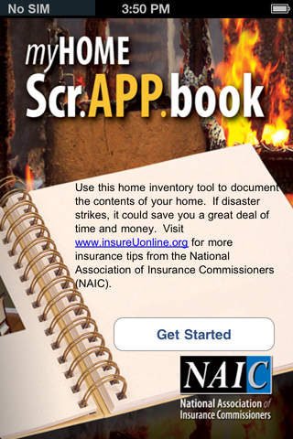


Home Inventory Tools

Slide 9
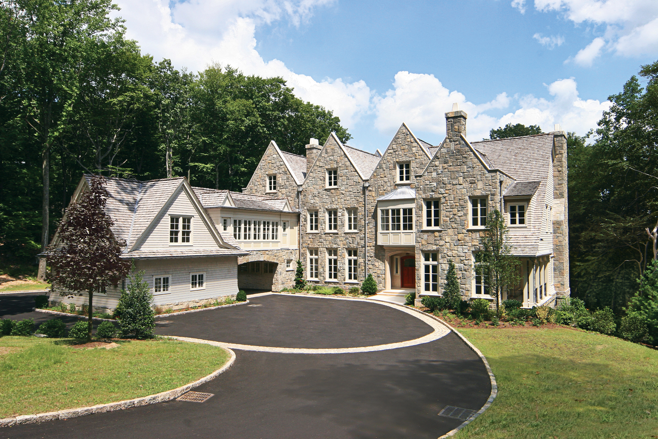

The Price is Right
Homeowners Insurance

Slide 10
The Price is Right
In each room are objects and you have to guess what it would cost to replace them.
The team that guesses closest without going over earns 1 point.
The team with the most points at the end of the game wins.
There are also insurance quizzes throughout, so be ready. Quizzes are worth 5 points!

Slide 11
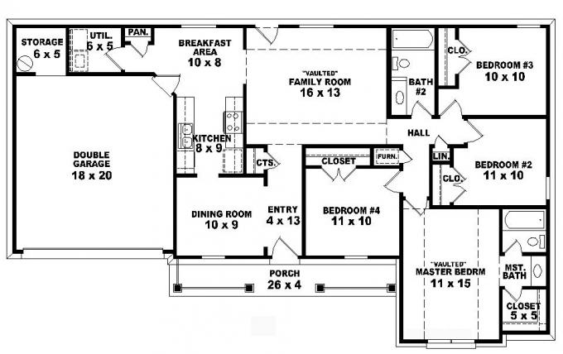

Kitchen
Living room
Girl’s room
Garage
Boy’s room
Game
room
Master bedroom
Finished

Slide 12

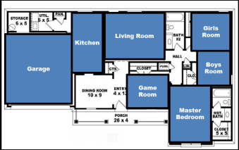

Slide 13
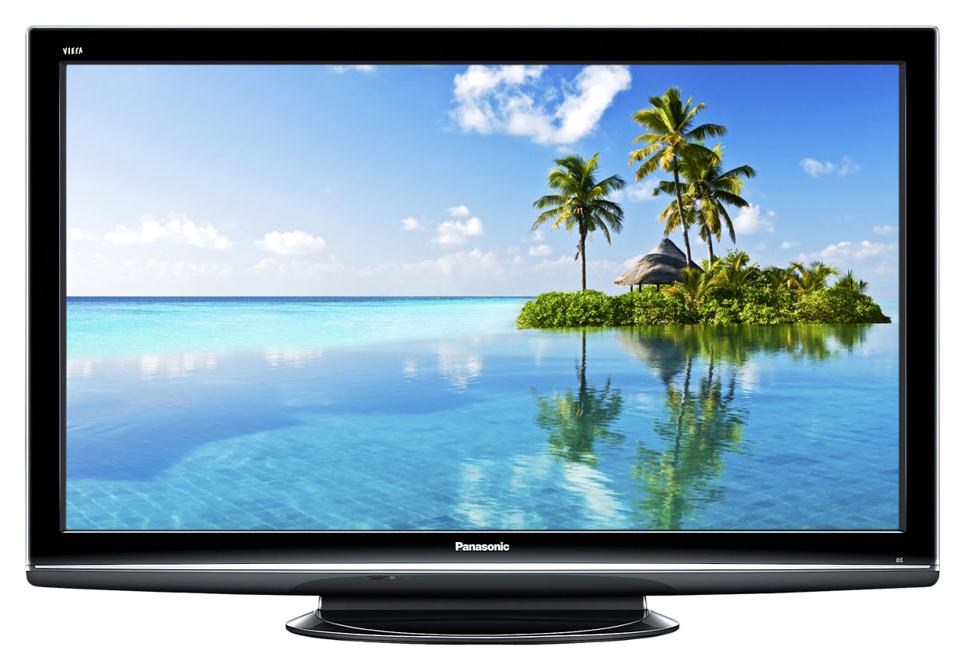

How much would it cost to replace this
60-inch TV?
End
1
2
3
4
5
6
7
8
9
10
$
800

Slide 14
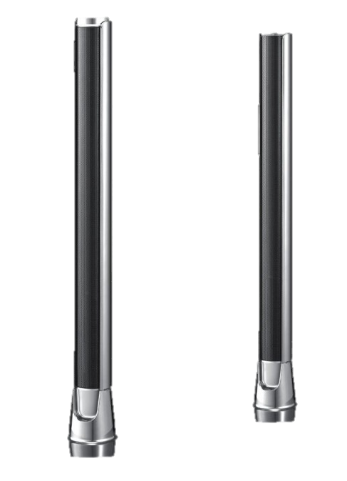
How much would it cost to replace these two TV speakers?
$
290
End
1
2
3
4
5
6
7
8
9
10

Slide 15
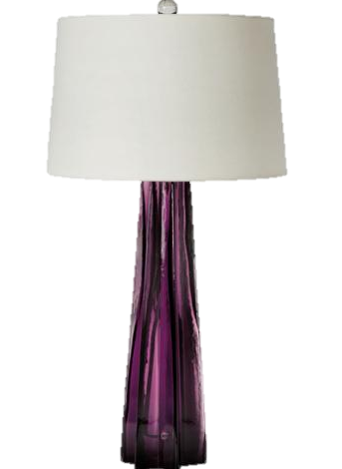
How much would it cost to replace this lamp?
$
75
End
1
2
3
4
5
6
7
8
9
10

Slide 16
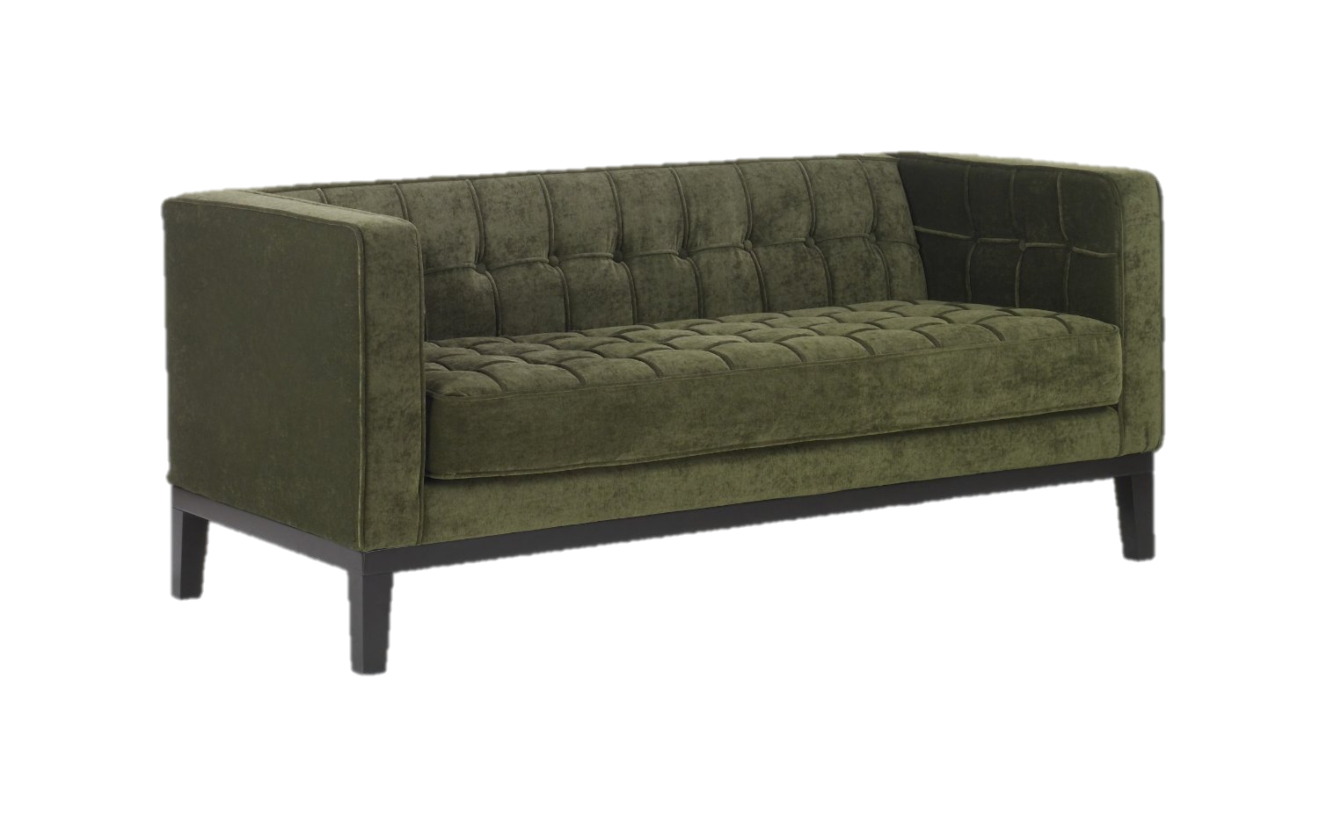
How much would it cost to replace this couch?
End
1
2
3
4
5
6
7
8
9
10
900
$

Slide 17
The Price is Right
POP QUIZ
Homeowners Insurance

Slide 18




Can your insurance company cancel or not renew your policy because you own a dog?
YES
End
1
2
3
4
5
6
7
8
9
10
11
12
13
14
15
16
17
18
19
20
21
22
23
24
25
26
27
28
29
30
Dog bite claims can be rather expensive, and some insurers choose not to provide insurance to homeowners who own a breed with a history that suggests a dog bite claim is more likely.

Slide 19
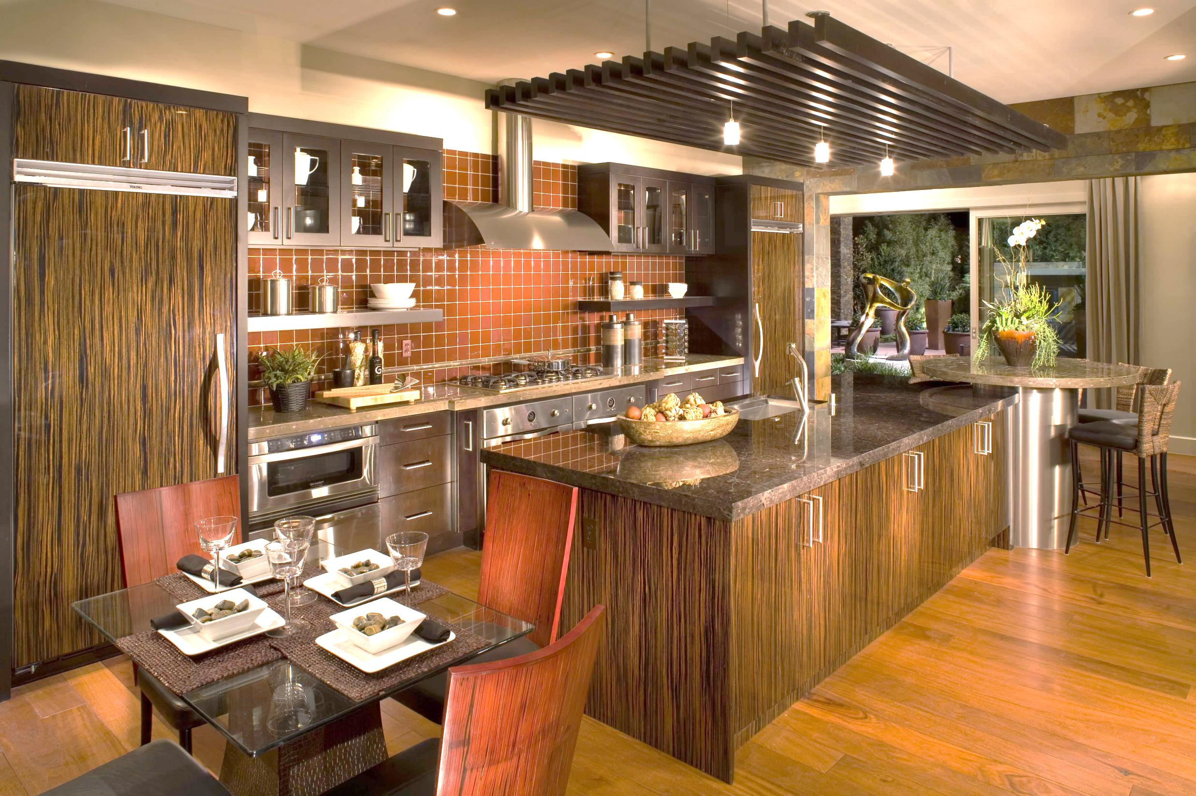
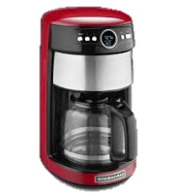
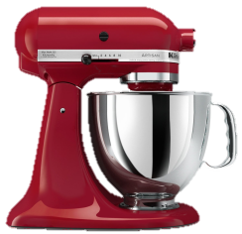

Slide 20


How much would it cost to replace this dining table set?
$
1,560
End
1
2
3
4
5
6
7
8
9
10

Slide 21
How much would it cost to replace this stand mixer?
End
$
265
1
2
3
4
5
6
7
8
9
10

Slide 22
How much would it cost to replace this coffee maker?
End
1
2
3
4
5
6
7
8
9
10
$
71.80

Slide 23
The Price is Right
POP QUIZ
Homeowners Insurance

Slide 24
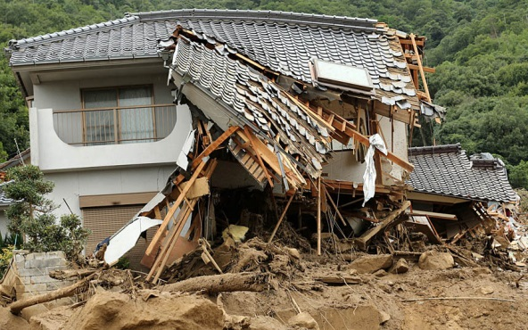
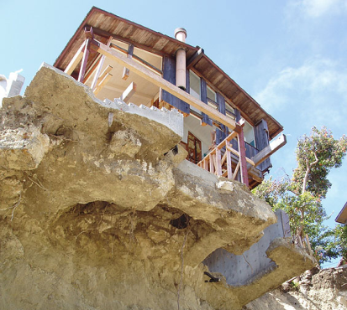
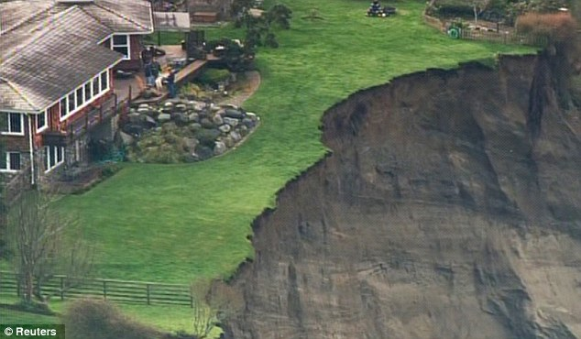

Will your homeowners insurance policy pay for damage to your home caused by a landslide?
NO
End
1
2
3
4
5
6
7
8
9
10
11
12
13
14
15
16
17
18
19
20
21
22
23
24
25
26
27
28
29
30
Surprisingly, homeowners policies do not cover damage caused by
earth movement. There is specialty coverage available for landslides.
It’s expensive and difficult to find. Earthquake Insurance does not
cover landslides.

Slide 25


Slide 26


How much would it cost to replace this iPad?
End
1
2
3
4
5
6
7
8
9
10
$
449.99

Slide 27
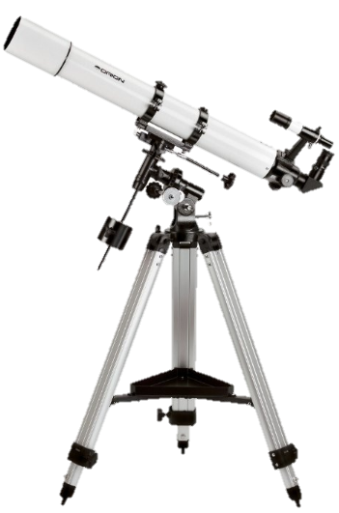
How much would it cost to replace this telescope?
$
299.99
End
1
2
3
4
5
6
7
8
9
10

Slide 28
How much would it cost to replace this bed?
$
125.99
End
1
2
3
4
5
6
7
8
9
10

Slide 29
The Price is Right
POP QUIZ
Homeowners Insurance

Slide 30
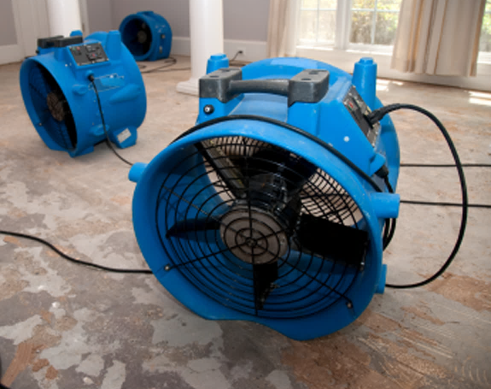

When it comes to homeowners and renters insurance what does ALE stand for?
Additional
Living
Expenses
End
1
2
3
4
5
6
7
8
9
10
11
12
13
14
15
16
17
18
19
20
21
22
23
24
25
26
27
28
29
30

Slide 31


Slide 32
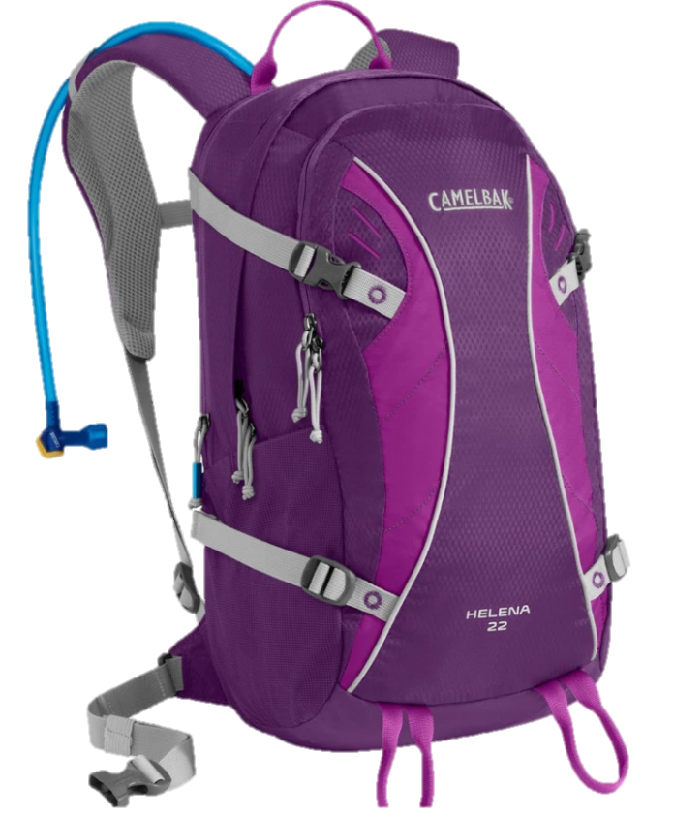

How much would it cost to replace this backpack?
End
$
88.60
1
2
3
4
5
6
7
8
9
10

Slide 33
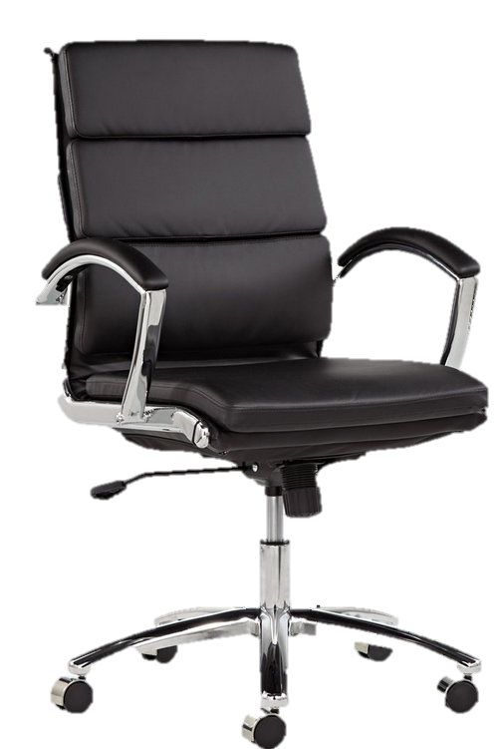
How much would it cost to replace this desk chair?
$
250
End
1
2
3
4
5
6
7
8
9
10

Slide 34
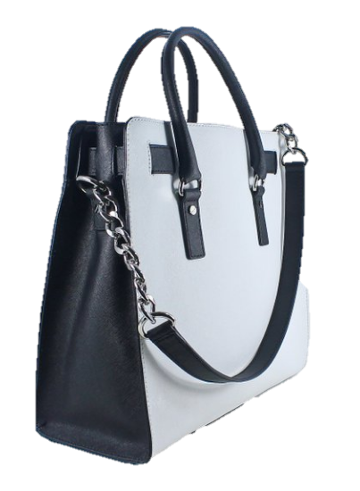
How much would it cost to replace this purse?
$
358
End
1
2
3
4
5
6
7
8
9
10

Slide 35
The Price is Right
POP QUIZ
Homeowners Insurance

Slide 36

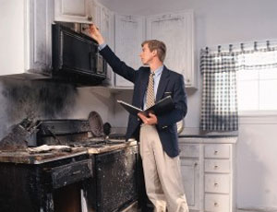
What are “smoke chasers”?
A repair business that arrives when your house is on fire

Slide 37
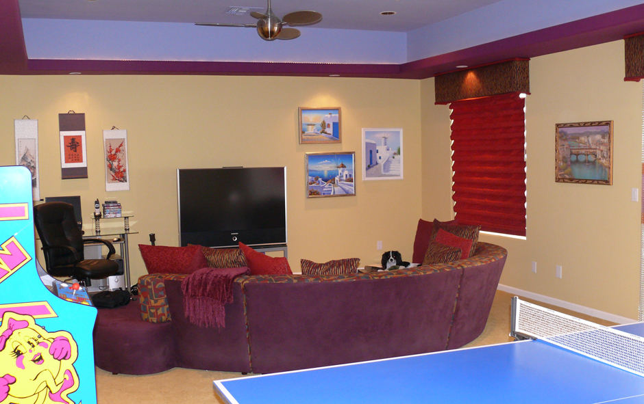

Slide 38


How much would it cost to replace this Ms. Pac-Man arcade game?
$
2,849
End
1
2
3
4
5
6
7
8
9
10

Slide 39



How much would it cost to replace these three framed
prints of Greece?
$
325
End
1
2
3
4
5
6
7
8
9
10

Slide 40
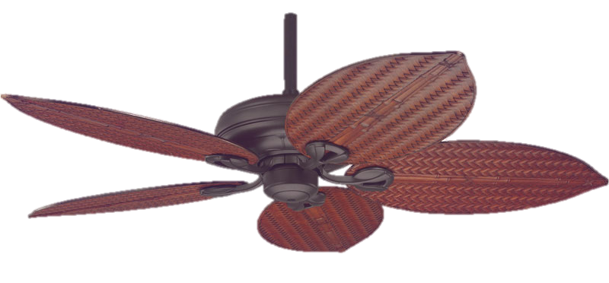
How much would it cost to replace this ceiling fan?
$
409
End
1
2
3
4
5
6
7
8
9
10

Slide 41
The Price is Right
POP QUIZ
Homeowners Insurance

Slide 42
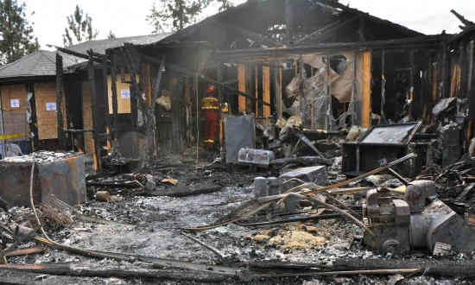
Does renters insurance cover the cost to repair the home in the case of a fire?
Renters insurance covers only the cost of the items in the home. Homeowners insurance pays for the damages to the house.
NO
End
1
2
3
4
5
6
7
8
9
10
11
12
13
14
15
16
17
18
19
20
21
22
23
24
25
26
27
28
29
30

Slide 43
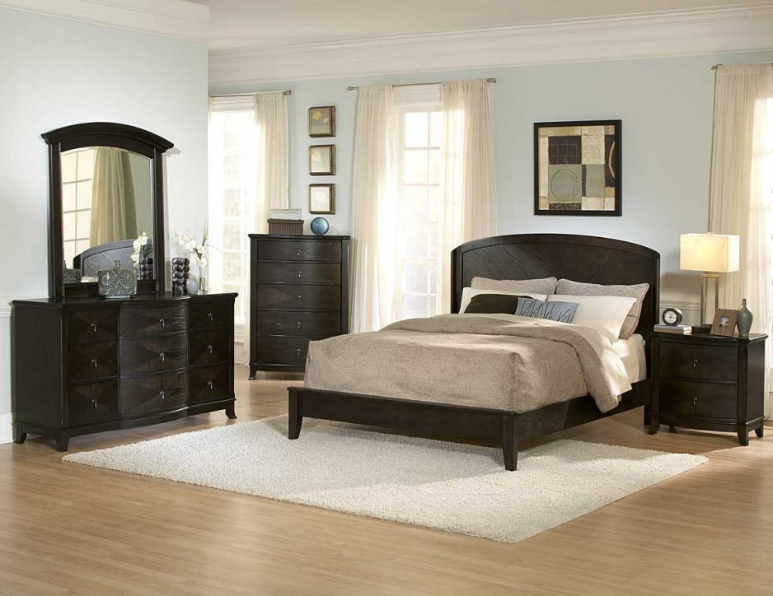

Slide 44
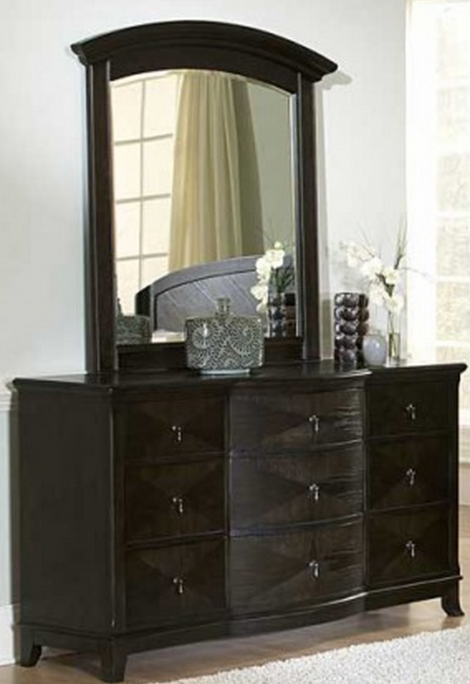

How much would it cost to replace this dresser?
$
856.25
End
1
2
3
4
5
6
7
8
9
10

Slide 45


How much would it cost to replace this table lamp?
$
109
End
1
2
3
4
5
6
7
8
9
10

Slide 46
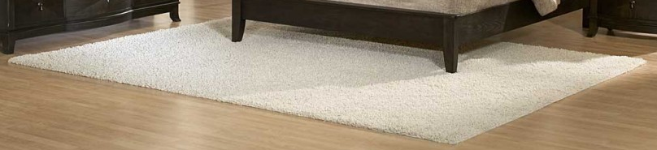
How much would it cost to replace this rug?
$
147
End
1
2
3
4
5
6
7
8
9
10

Slide 47
The Price is Right
POP QUIZ
Homeowners Insurance

Slide 48
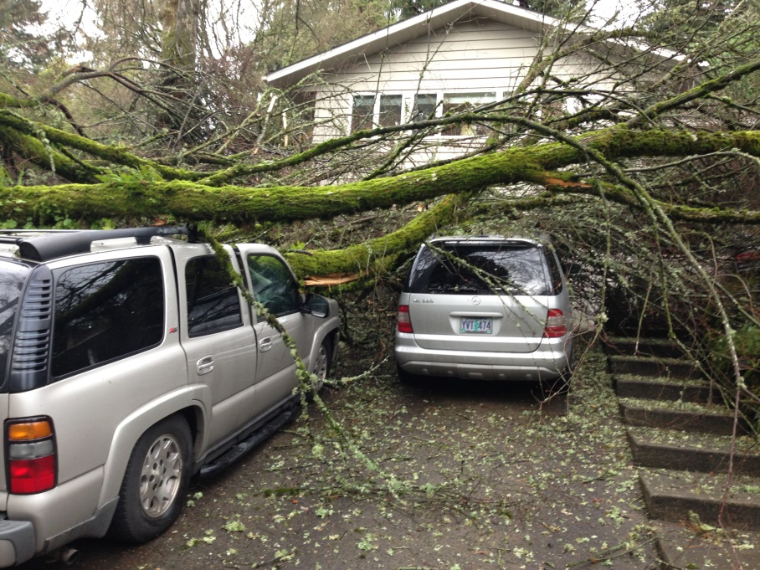
Would a homeowners or auto policy cover this?
Homeowners insurance does not cover vehicles. This would be covered by an auto insurance policy.
Auto
End
1
2
3
4
5
6
7
8
9
10
11
12
13
14
15
16
17
18
19
20
21
22
23
24
25
26
27
28
29
30

Slide 49
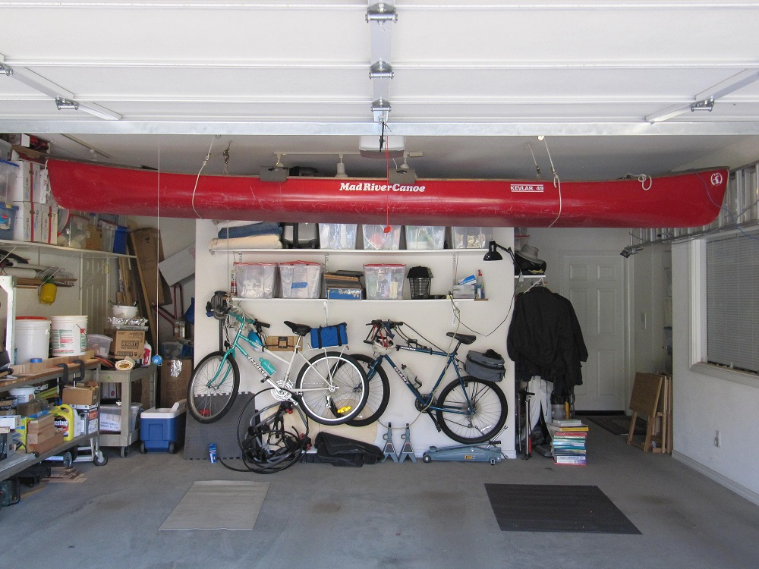
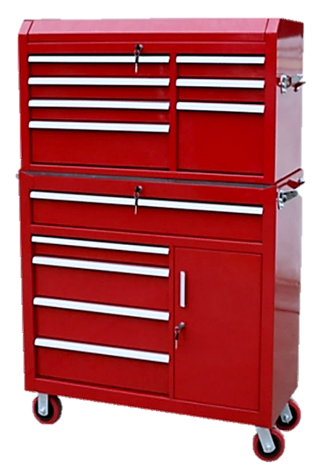
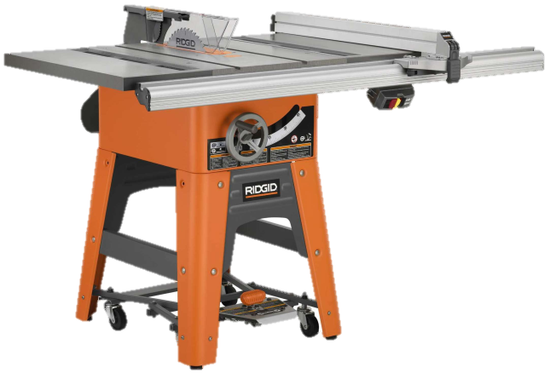


Slide 50
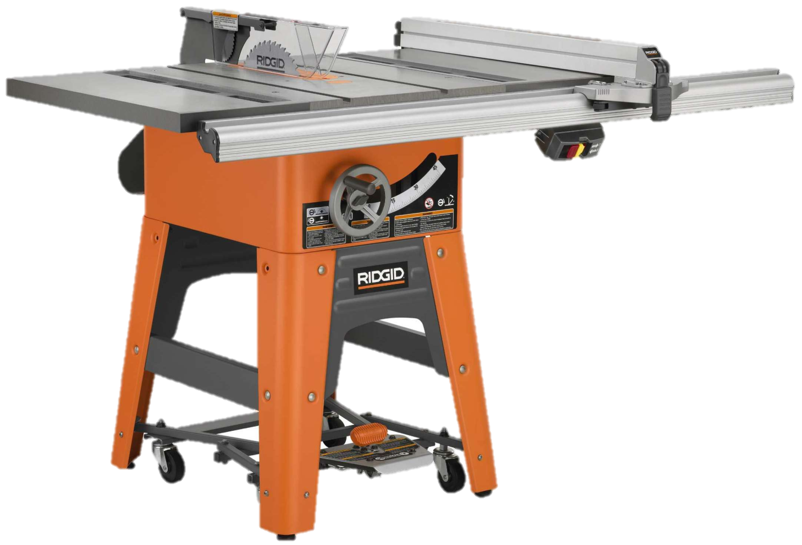
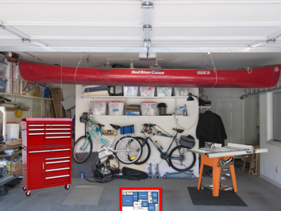
How much would it cost to replace this table saw?
$
522
End
1
2
3
4
5
6
7
8
9
10

Slide 51
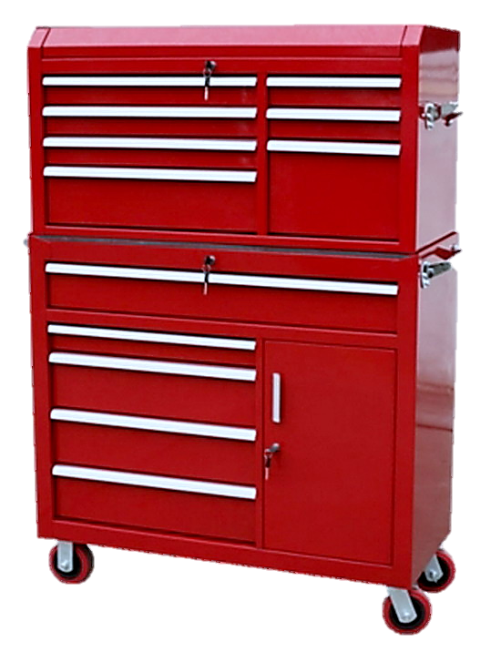
How much would it cost to replace this toolbox?
$
160
End
1
2
3
4
5
6
7
8
9
10

Slide 52

How much would it cost to replace this canoe?
$
688
End
1
2
3
4
5
6
7
8
9
10

Slide 53
The Price is Right
POP QUIZ
Homeowners Insurance

Slide 54
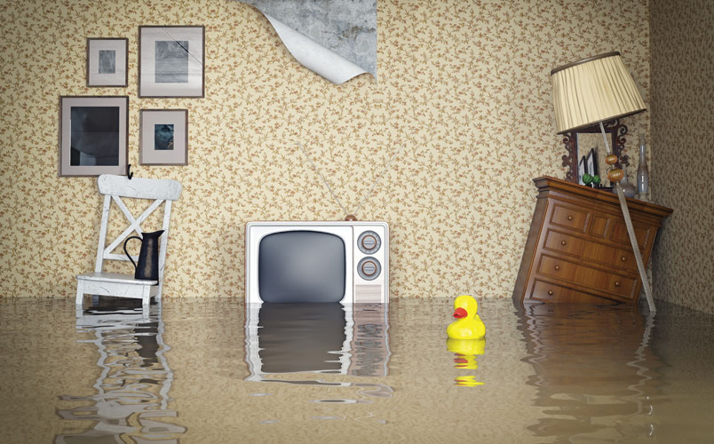
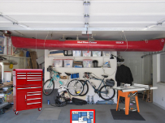
Would a homeowners policy or a renters policy provide coverage for this flood damage?
Homeowners and renters insurance do not cover flood damage.
This would be covered by an separate flood insurance plan.
End
1
2
3
4
5
6
7
8
9
10
11
12
13
14
15
16
17
18
19
20
21
22
23
24
25
26
27
28
29
No
30

Slide 55



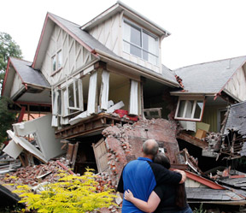
The Price is Right
Homeowners Insurance

